Slide 1
FARMERVISION · MILESTONE 3
Model architecture and pipeline design
From raw farmer input — text, photo, or voice — to delivered advice, inside a 200–300 ms budget on the core reasoning path.
Milestone 3 report
·
July 2026
Notes:
Milestone 3 covers model selection and the full pipeline design. M1 and M2 context assumed: three farmer needs — disease diagnosis, scheme lookup, yield and profitability guidance — over text, photo, and voice, Hindi-first.

Slide 2
FARMERVISION · MILESTONE 3
Scope of this milestone
Selects and justifies the model behind each module — vision, retrieval, yield, synthesis, voice.
Decide the overall architecture of the project.
Justification of the architecture, tools and models used.
Design-phase status: latency figures and hyperparameters are estimates until Milestone 4 measures them.
Notes:
Design-phase document: latency figures and hyperparameters are grounded in published benchmarks and standard practice, not measured on this system. Appendix G maps every assumption to a validation method in Milestone 4.

Slide 3
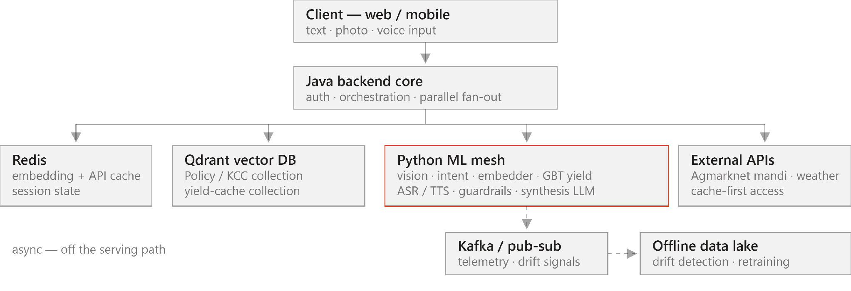
FARMERVISION · MILESTONE 3
System architecture
Notes:
One orchestration layer, one ML mesh. The backend fans out in parallel and never blocks on the async row — Kafka, the data lake, and retraining are fully decoupled from serving.

Slide 4
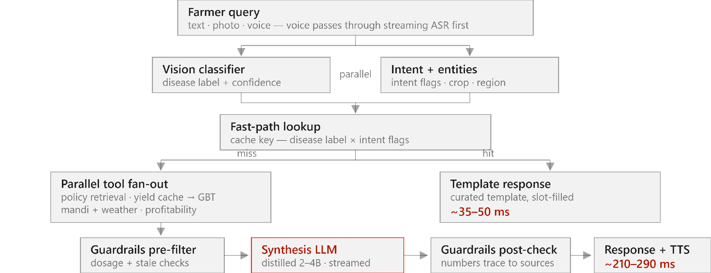
FARMERVISION · MILESTONE 3
Request flow, input to answer
Notes:
Vision and intent extraction run in parallel and build the fast-path cache key. A hit returns a curated template in about 35 to 50 ms. On a miss, all tools fire in one parallel batch before the LLM runs — the LLM only turns validated facts into language.

Slide 5
FARMERVISION · MILESTONE 3
Model selection by module
MODULE
MODEL
ORIGIN
SIZE
Vision — disease
ViT-Small (edge fallback: MobileViT-XXS)
ImageNet-pretrained → fine-tuned
22–86M
Text embedding
MuRIL-base — code-mix aware
pretrained · optional contrastive tune
236M
Intent + entities
DistilBERT-class, joint head
pretrained → fine-tuned
66M
Yield prediction
XGBoost / LightGBM
trained from scratch
tree ensemble
Synthesis
Gemma — 12B teacher, distilled student
distilled in Milestone 4
2–4B
ASR
IndicWhisper / Bhashini-class
pretrained → dialect fine-tune
0.25–1.5B
TTS
VITS / FastSpeech2-class, Indic
pretrained
30–90M
Notes:
Seven learned models. Not in the table: rule-based profitability and guardrails components, a 350–500M speculative draft model sharing the synthesis tokenizer, and IndicTrans2 for dialect normalization.

Slide 6
FARMERVISION · MILESTONE 3
Design decisions and alternatives
Distill 12B → 2–4B for synthesis
GBT for yield; vectors only as cache
A 12B decoder cannot generate inside the 150–180 ms slice. The student keeps the teacher’s domain behavior at a servable size.
k-NN averaging underperforms boosted trees on tabular regression — the cache sits in front of the model, never in place of it.
Tool selection before generation
Rule-based guardrails, two stages
The extractor picks tools upfront; all fire in one parallel batch. A turn-by-turn agent loop survives only as the slow-path fallback.
Pre-filter on retrieved data, post-check on generated text — no second generation pass, and every rule stays auditable.
Notes:
Each decision was made against a concrete alternative. The first three rate high confidence — decode-time arithmetic and established tabular-ML results. Guardrail recall vs an LLM-based check still needs empirical comparison.

Slide 7
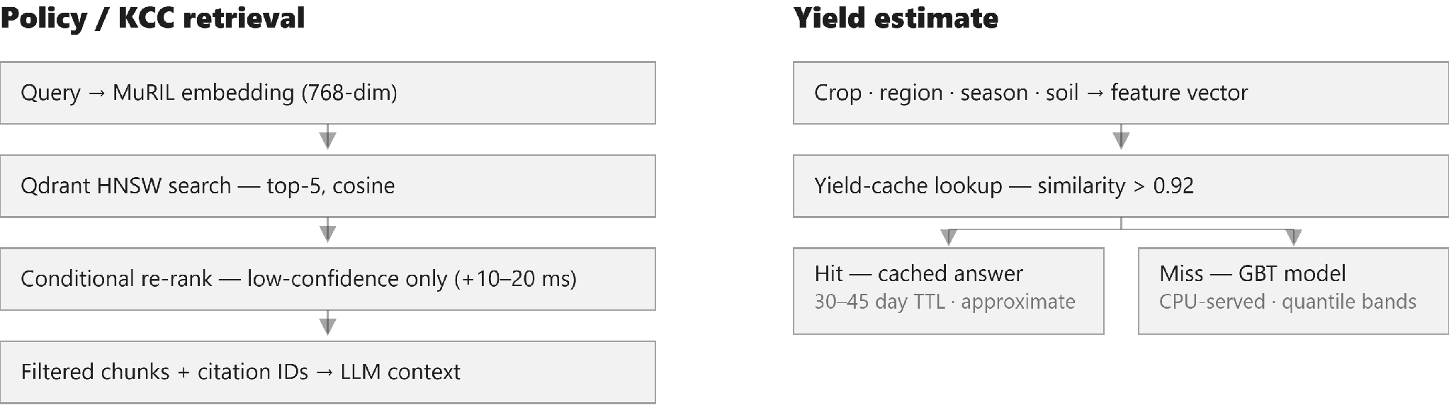
FARMERVISION · MILESTONE 3
Retrieval and yield caching
Two separate embedding spaces — the semantic policy index never shares a collection with the structured yield cache.
Notes:
Two separate Qdrant collections in different embedding spaces. Re-ranking is conditional — only when the top-1 score is low, adding 10 to 20 ms on ambiguous queries. Yield-cache hits are labeled approximate and expire on a seasonal TTL.

Slide 8
FARMERVISION · MILESTONE 3
Synthesis and guardrails
Prompt assembly — fixed order
Two-stage guardrails
01
System rules
role, safety limits, format
Pre-filter
validates retrieved data before synthesis — dosage bounds, staleness flags
02
Retrieved chunks
policy passages + citation IDs
Post-check
scans generated text — untraced numbers, banned terms, language
03
Tool data
yield · price · profitability · flags
04
Farmer query
original text, post-ASR if spoken
Fail-closed
a guardrail outage never returns unvalidated advice
05
Output format
guided decoding, 60–100 tokens
No agent loop
tools fire upfront in parallel; a dynamic loop only as slow-path fallback
Notes:
The LLM only references values present in the supplied context; the post-check flags any number that does not trace back to a source. Both stages are rules and small classifiers — no second generation pass. Guardrail outage fails closed.

Slide 9
FARMERVISION · MILESTONE 3
Latency budget and serving
design estimates — benchmarked in Milestone 4
PATH
ESTIMATE
WHAT IT COVERS
Fast path
~35–50 ms
template served on a cache hit
Slow path
~210–290 ms
full fan-out, synthesis, both guardrail stages
Voice input
+150–400 ms
ASR finalization before the pipeline starts
Voice output
streamed
TTS begins on the first completed sentence
Synthesis LLM
Small models
Yield model
A100/H100-class, FP8 on vLLM — batched, with speculative decoding.
T4/L4-class or CPU — TensorRT / ONNX for vision, intent, embedders.
CPU only — the boosted-tree ensemble needs no GPU anywhere in its path.
Notes:
These are architectural estimates from published throughput figures for comparable model sizes — Milestone 4 benchmarks them on real hardware under concurrent load. Voice output streams alongside generation, so it does not stack onto the total.

Slide 10
FARMERVISION · MILESTONE 3
Validation plan for Milestone 4
Assumptions to validate — Appendix G
Milestone 4 activities
150–180 ms generation slice — throughput benchmark on the distilled checkpoint
Student accuracy vs the 12B teacher — held-out agri-QA set
GBT vs k-NN and neural baselines — cross-validated on real yield data
Guardrail recall — adversarial red-team queries
MuRIL vs multilingual-e5 — recall@k on code-mixed queries
Assemble and clean the training datasets
Fine-tune the vision classifier; per-class F1 baseline
Build the distillation pipeline — teacher output → student fine-tune
Curate the initial fast-path template set
Integrate and load-test against the latency targets
Notes:
Appendix G is the bridge to Milestone 4: every design assumption is a falsifiable claim with a named test. The activities on the right produce a measured result for each row, not just a working system.

